Slide 1
Data Warehousing and Business Intelligence
Group 7:
Abhitej Kodali
Balaji Katakam
Divyaj Podar
Tej Modi
Twinkle Ghatoriya
Niyati Shah

Slide 2
Table of Contents
About the industry/ organization
Kimball lifecycle diagram
High level bus matrix
Opportunity matrix
Prioritization Grid
Detailed bus matrix
Preparing a dimensional model
Logical fact table
Detailed fact table
Dimension attribute detail diagram
Conformed dimensions
Representative transformation rules
Aggregate table

Slide 3
About the Organization
XZ sporting goods company manufactures different types of sports goods and sells it to retailers all around the world.
They take in orders via different forms such as:
Fax
Telephone
Web
Email, etc.
They have several product line and several products such as
Eye wear – Capri, Cat Eye, Dante etc.
Knives - Max Gizmo, Pocket Gizmo etc.

Slide 4
Kimball Lifecycle Diagram
Business Requirements
Definition
Technical Architecture Design
Product Selection and Installation
Growth
Program/ Project Planning
Dimensional Modeling
Physical Design
ETL Design and Development
Deployment
BI Application Design
BI Application Development
Maintenance
Program/ Project Management

Slide 5
High Level Bus Matrix
Common Dimensions
 | Date | Retailer | Product | Order Method | Shipping Method
1) Taking Order | X | X | X | X | X
2) Invoicing | X | X | X | X | X
3) Shipping | X | X | X |  | X
4) Receiving Payment | X | X | X
5) Returns Processing | X | X | X |  | X
6) Payment on Returns | X | X | X
Business Process/ Event

Slide 6
Opportunity Matrix
Organization/ Workgroup
 | Sales Department | Finance Department | Customer Service | Logistics
1) Taking Order | X
2) Invoicing | X | X |  | X
3) Shipping | X |  |  | X
4) Receiving Payment | X | X
5) Returns Processing |  |  | X | X
6) Payment on Returns |  | X | X
Business Process/ Event

Slide 7
Prioritization Grid
High
BP 3
BP 4
BP 5
BP 1
Potential Business Impact
BP 2
BP 6
Low
High
Feasibility

Slide 8
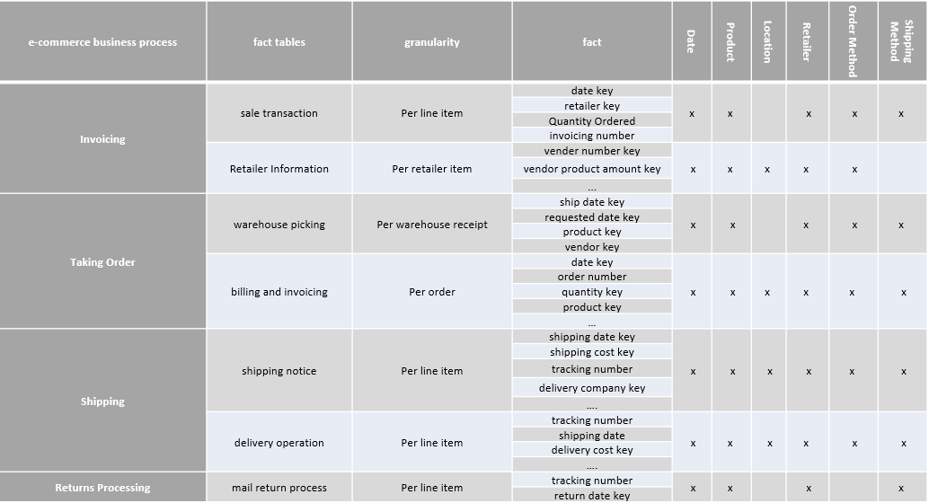
Detailed Bus Matrix

Slide 9
Preparing a Dimensional Model
Step 1: Choosing the business process:
- Taking order from the customer
Step 2: Declare the grain:
- Every single transaction that the customer is making with the organization for a product
Step 3: Identifying the dimensions:
- The dimensions of the fact table are
Date, Retailer, Product, Order Method, Shipping Method
Step 4: Identify the facts:
- The facts of the fact table are
Sales value, Quantity ordered, Discount offered, Net Cost

Slide 10
Logical Fact Table
Shipping Method
(Dimension)
Order Method
(Dimension)
Date
(Dimension)
Taking Order
(Fact Table)
Product
(Dimension)
Retailer
(Dimension)

Slide 11
Detailed Fact Table
Order Method (PK)
dimension
Date PK (dimension)
Quarter
Year
Billing _And_Invoicing Fact Table
Date (FK)
Retailer (FK)
Order Method (FK)
Shipping Method (FK)
Product (FK)
Quantity Ordered
Price P.U
Discount P.U
Total Selling Price P.U
Total [(Price P.U – Discount P.U) * Quantity]
Retailer (PK) dimension
- Retailer Name
- Retailer Type
- Retailer Country
Shipping Method (PK)
Dimension
Product (PK) dimension
- Product line
- Product type

Slide 12
Dimension Attribute Detail Diagram - Product_Key
Attribute Name | Attribute Description | Cardinality | Slowly Changing Dimension Policy | Sample Values
Product ID | Product ID shows the unique key of the product | 88,476 | Not updatable | 37648
Product Name | Shows the name of the product | 145 | Not updatable | Husky Rope 50
Product Line | It is the line of products to which particular product types belong | 70 | Type 2 | Rope
Product Type | Product types consists of different types of products of that type | 30 | Type 2 | Mountaineering Equipment
Product Color | Shows the color of the product | 5 | Type 2 | black
Product Price | Product price shows the price of the product | 1 | Type 1 | $50
Product Cost | It is the cost taken to build the product | 1 | Type 1 | $30
Product Profit | It is the amount of profit made per product sold | 1 | Type 1 | $20

Slide 13
Conformed Dimensions
Conformed dimensions are the dimensions that can be used in multiple fact tables, the conformed fact tables in the case of EZ sports are:
Date
Retailer
Product
Order Method
Shipping Method

Slide 14
Representative Transformation Rules
Column | Detail
Revenue per unit (R.P.U.) | Derive by the division of Revenue per invoice by Quantity per invoice
Gross Profit | Derive by the multiplication of Revenue per invoice and Gross margin per invoice
Cost of Goods Sold | Derive by the subtraction of Revenue per invoice and Gross profit per invoice
Cost of Goods Sold per unit | Derive by the ratio of Cost of Goods Sold per invoice and Quantity per invoice
Profit per unit | Derive by the ratio of Gross Profit per invoice and Quantity per invoice

Slide 15
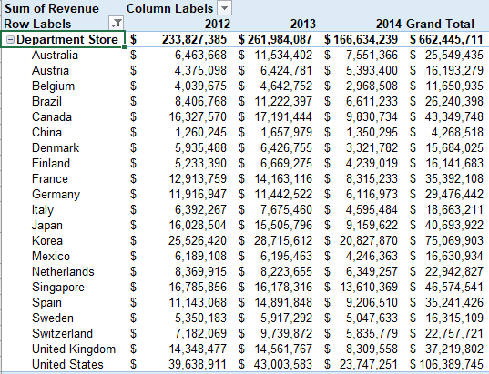
Aggregate Table

Slide 16
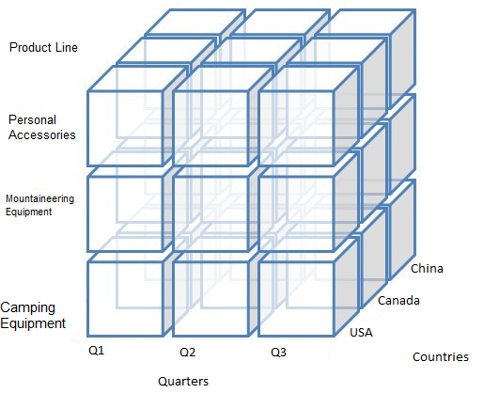
Cube

Slide 17
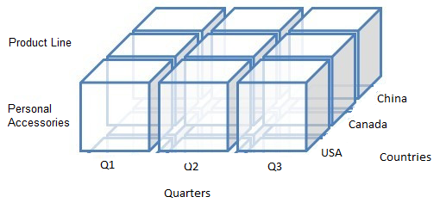
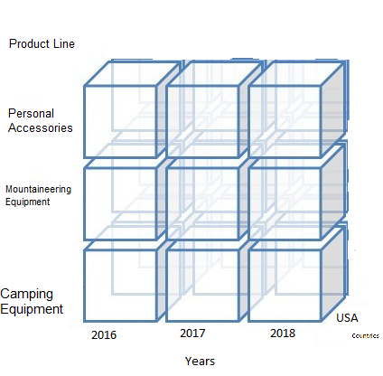
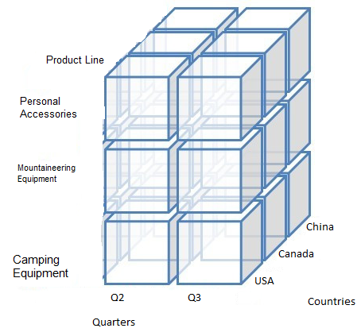
Cube (Continued)
Slice
Roll Up
Dice

Slide 18
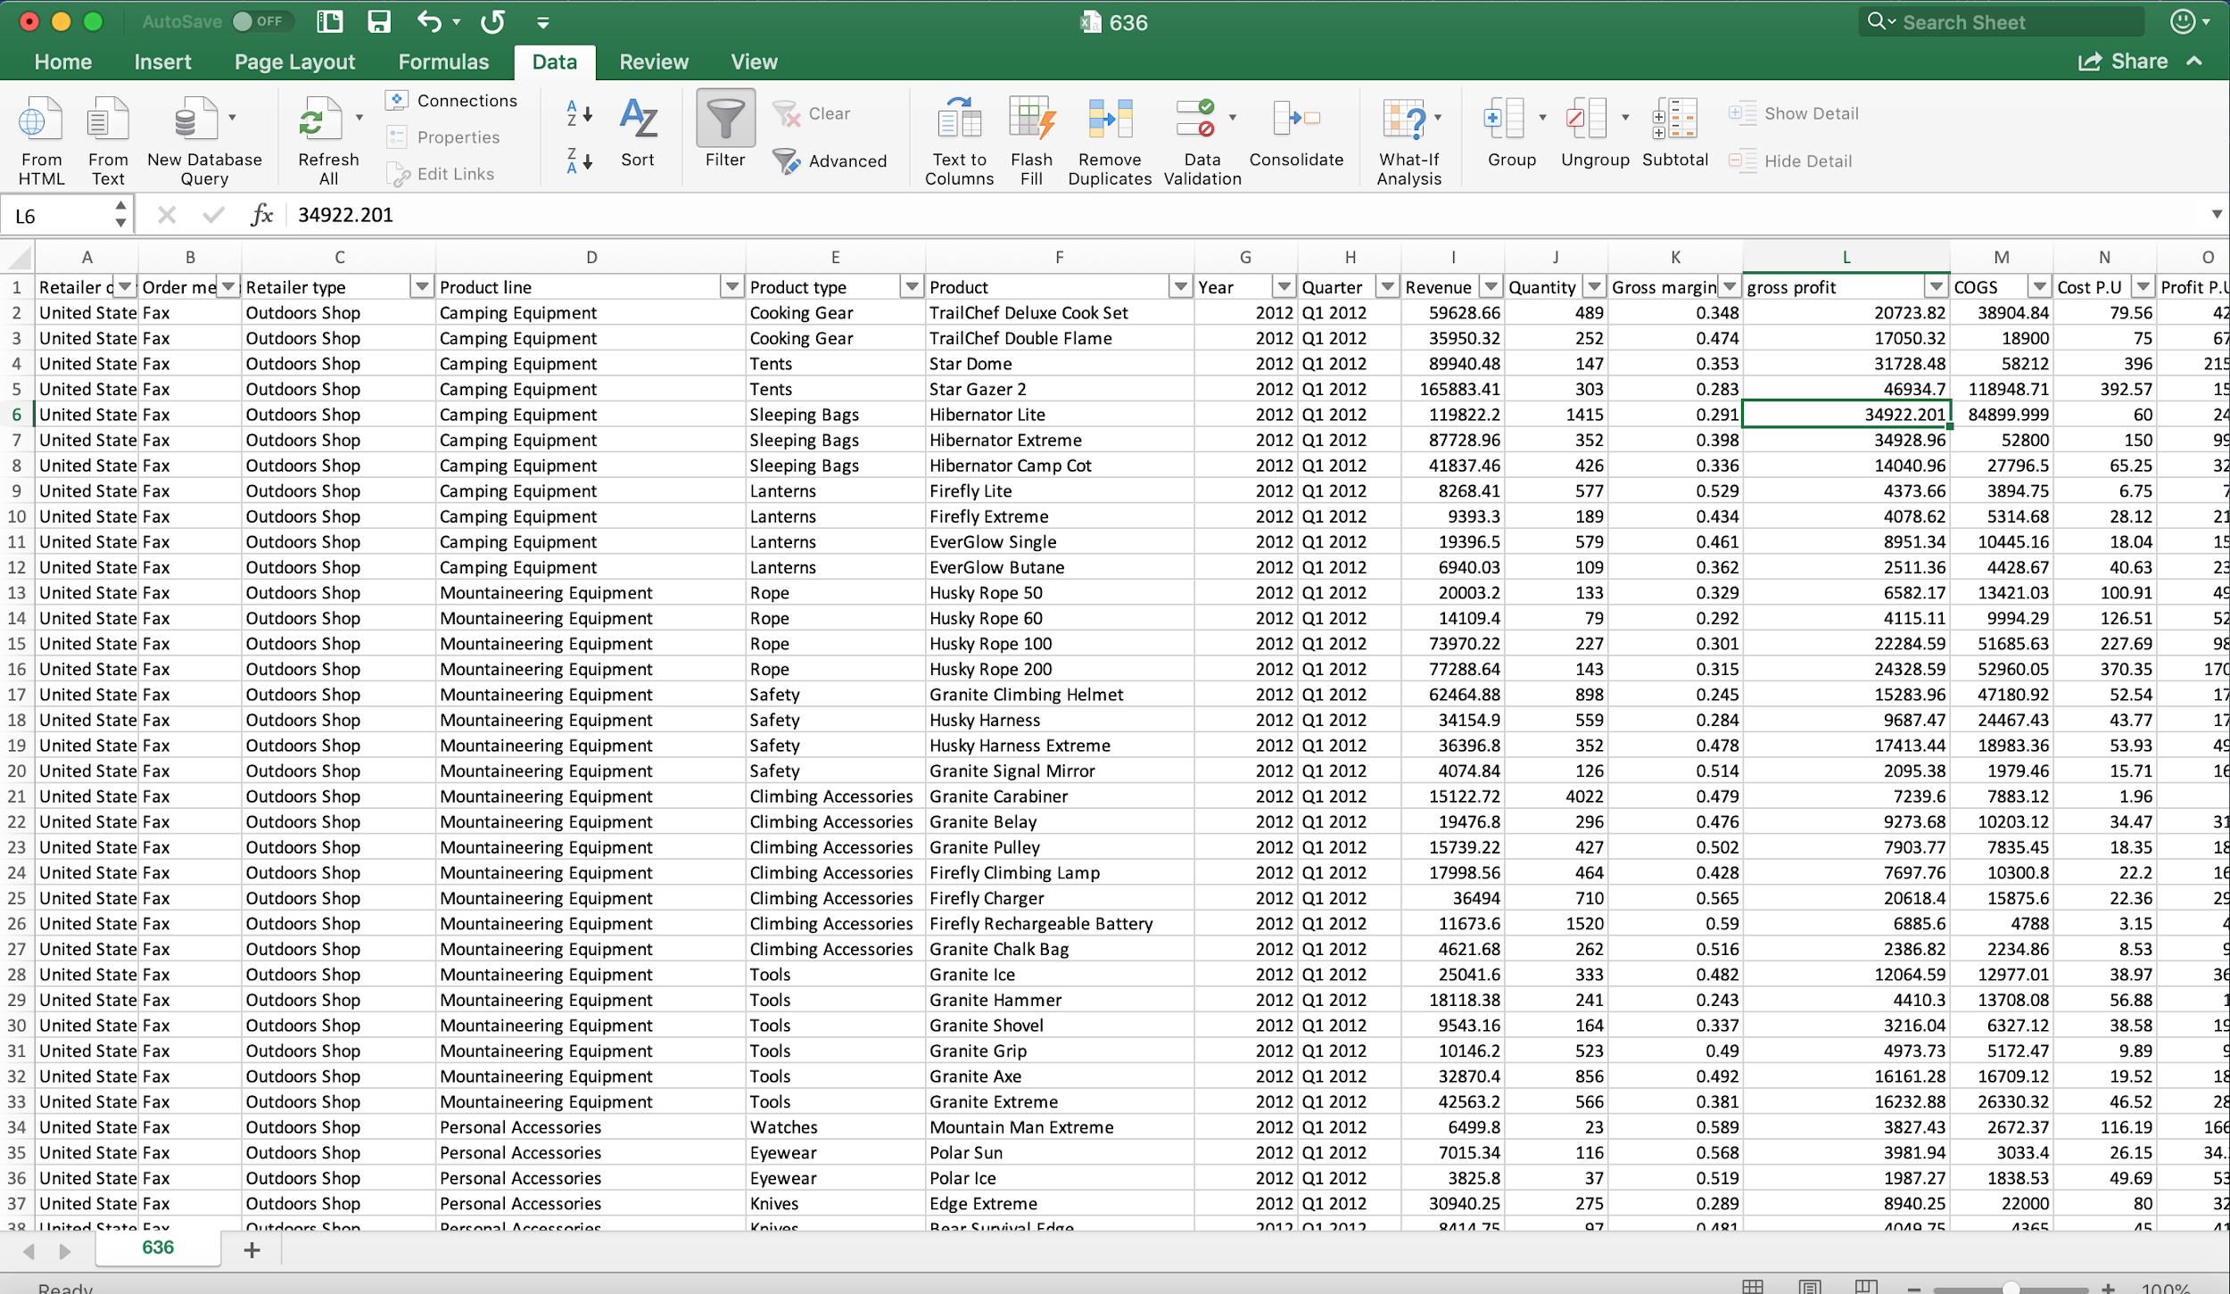
Dataset

Slide 19
Defining the Organization and Business Context
XZ is a sporting goods company who sells to different retailers who then sell the product to the customer:
The business context is as follows:
What is being traded? - Sports goods
When and how does it happen? - It is sold throughout the year and is sold via different methods such as web, fax etc.
Who is involved? - The retailers who will further sell the products to the customers and the employees of the EZ are involved

Slide 20
User and Task Analysis
User | Task
Analyst | Understand the trends and take an exploratory approach to make better business decisions
Financial Managers | They use the data to understand the financial situation of the organization and to check if the organization will be able to survive financially in the future or not
Operational Workers | They are interested in the data related to the normal operations to see if every tasks is going fine or if there are any inefficiencies
Marketing | Understand the type of retailers and the mode that they use to buy, the data is accessed by them to understand the customer and make advertisements accordingly

Slide 21
Visualizations

Slide 22
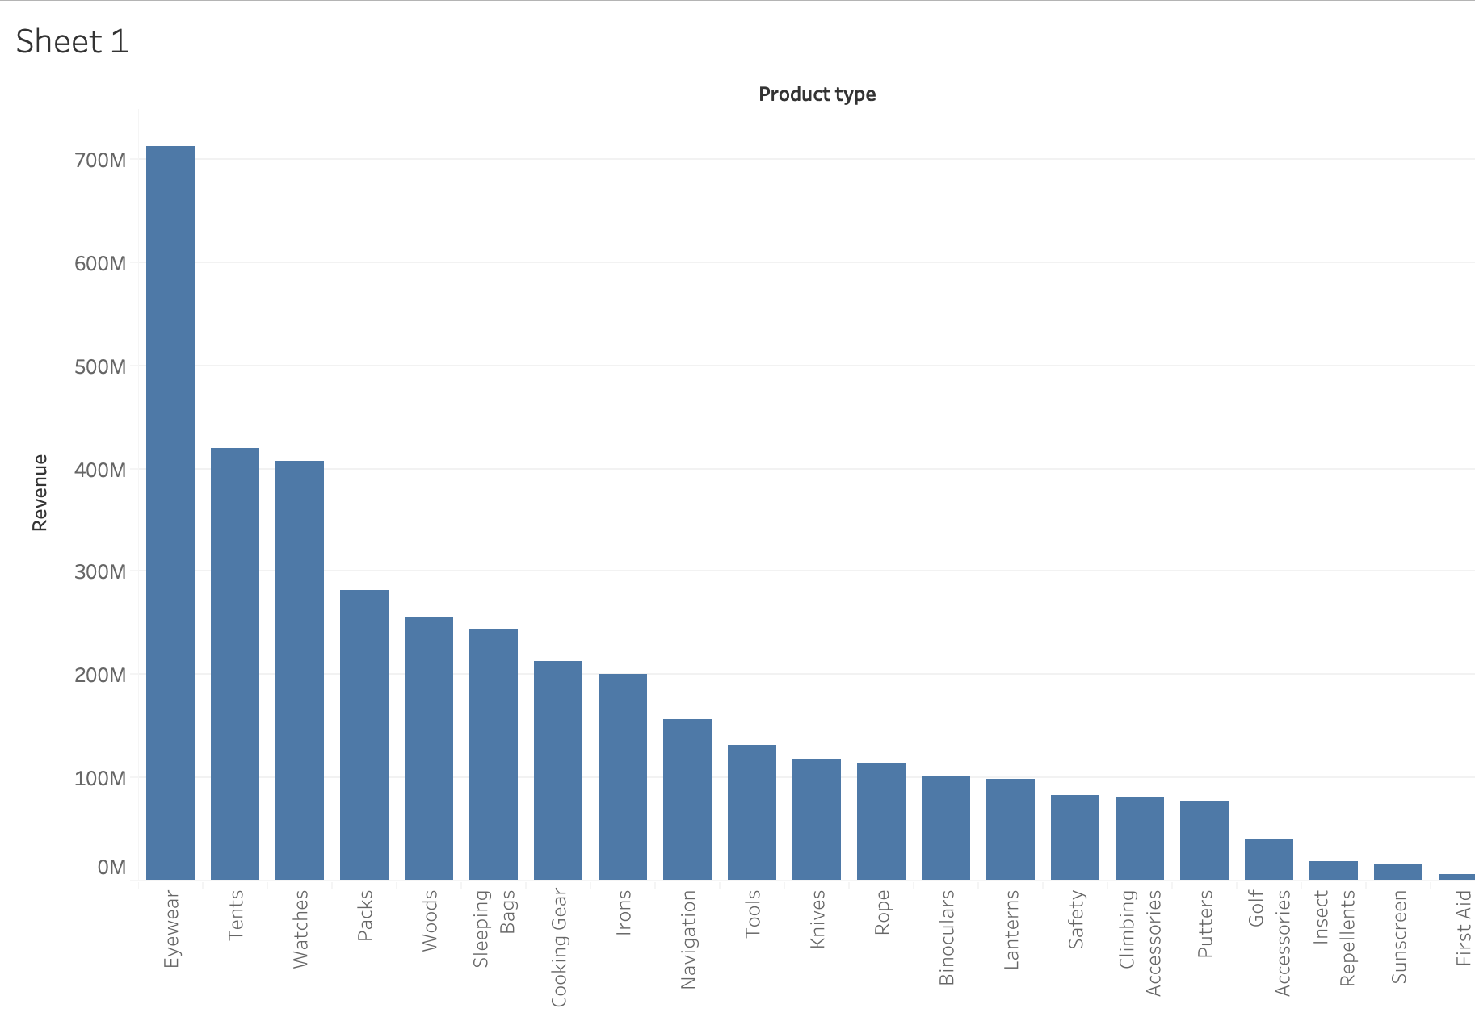
Sum of revenue earned from each product type
This chart helps us to understand how much sales are we making from each product type.
As we can see the top 3 revenue generators are from eyewear, tents and watches.
This helps us to understand which products to focus more on, which are the revenue generators

Slide 23
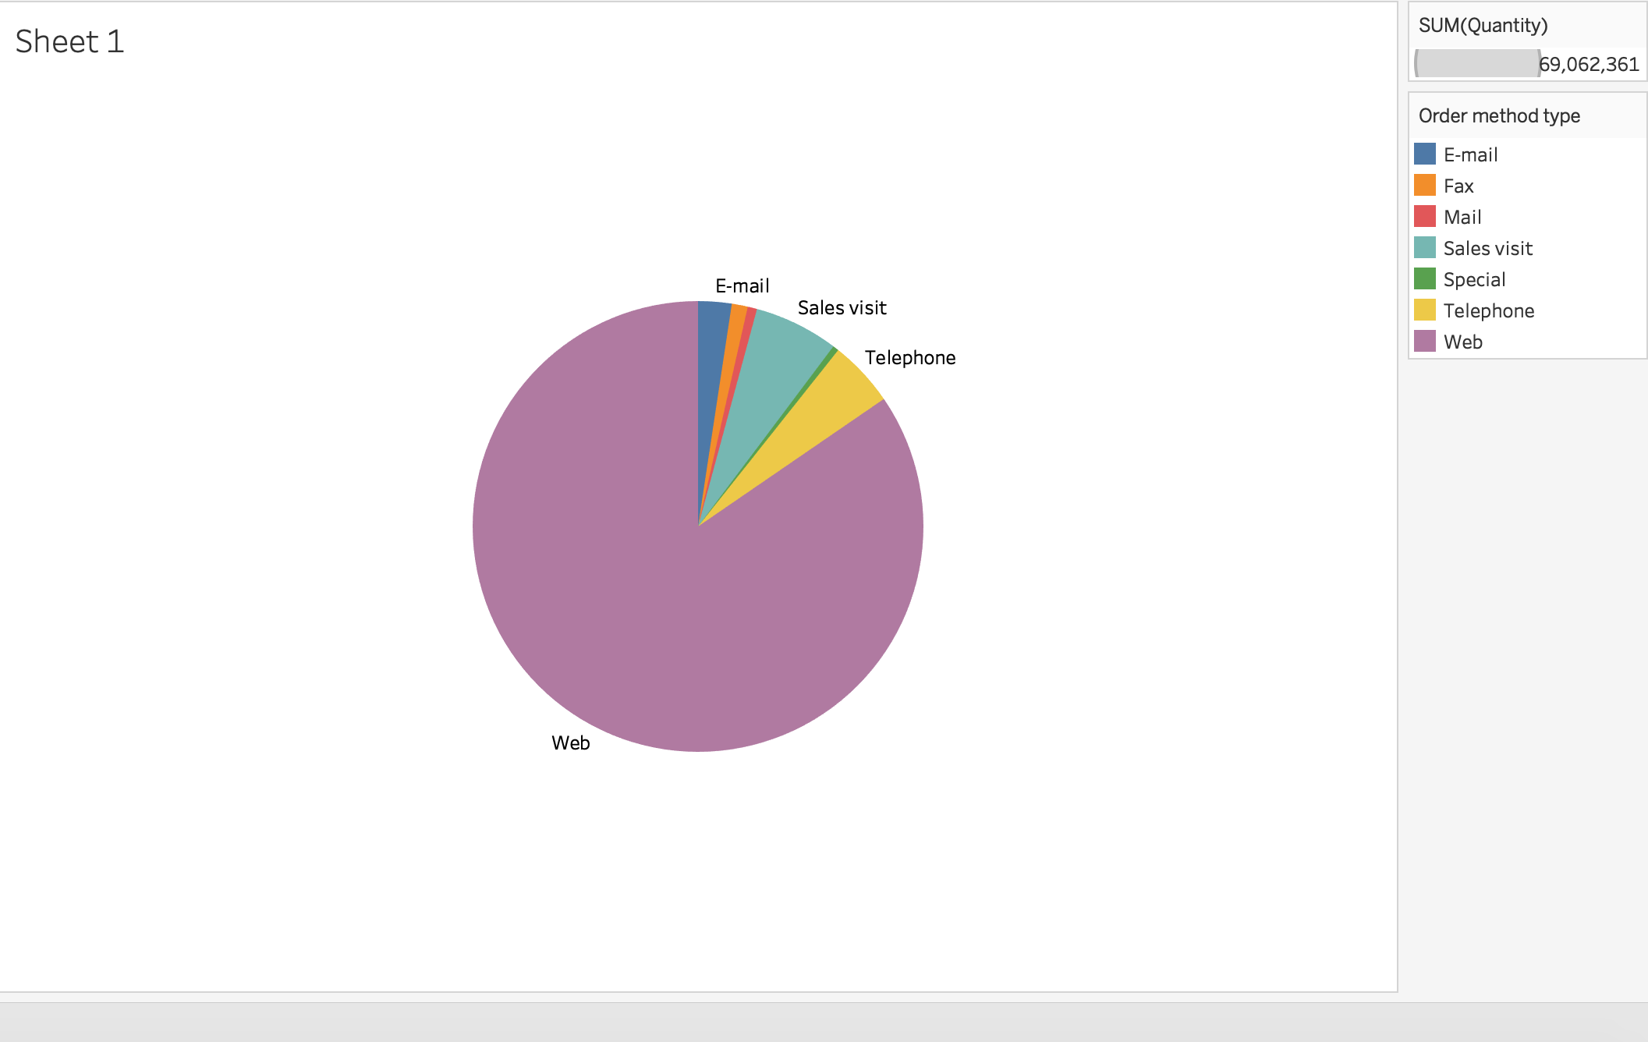
Different types of products used to order different products
This pie chart helps us understand how many orders are being places and by what method
As we can see the maximum amount of sales that XZ are making are through web.
More investments could be made to make the experience of online purchase better to increase the overall sales

Slide 24
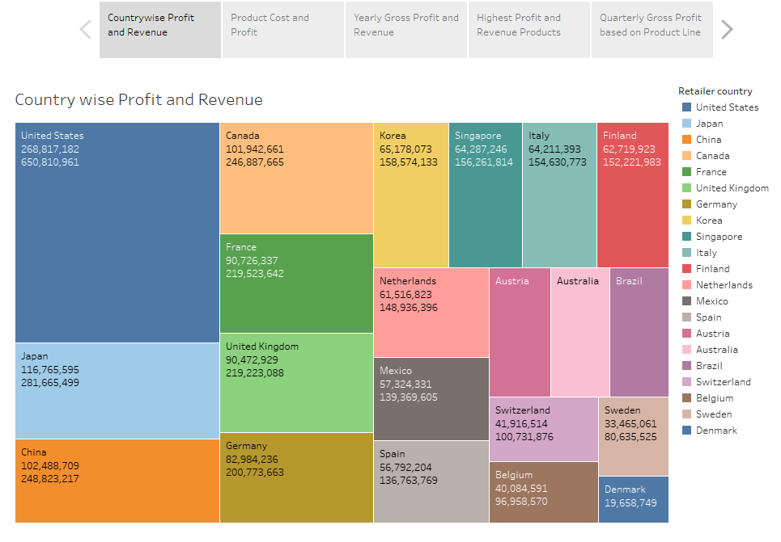
Country Wise Profit and Revenue
The Countries with highest Profit and Revenue are arranged in a descending order which make it easier to understand on where the products of the firm are highly successful.

Slide 25
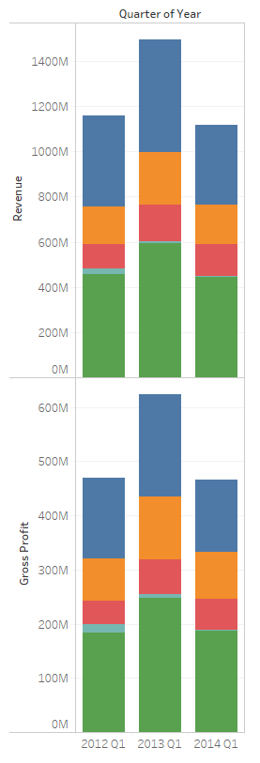
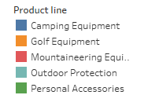
Revenue and Gross Profit for every product line
This visualization provides a sliced view
This shows the Gross Profit and Revenue for every type of product line for every quarter of the year
We can have a better understanding on which product lines bring higher revenue and profit in which quarter

Slide 26
Conclusion
Having a good data warehouse helps XZ in storing data warehouse in a standardized form, this helps in easy retrieval of the data for the purpose of BI and removes duplicate data and records
Business Intelligence helps XZ better understand their sales and helps them in analyzing which areas to invest more in and focus more on
Quick access to data is important and unless the data is not understandable by the business professionals there is no use of the data for the purpose of analysis. Data warehouse helps business to better understand the data and to work on it.

Slide 27
References
The Data Warehouse Toolkit: The Complete Guide to Dimensional Modeling Kimball, R. and Ross, M. Second Edition. John Wiley & Sons, 2006.
The Data Warehouse ETL Toolkit: Practical Techniques for Extracting, Cleaning, Conforming, and Delivering Data. Kimball, R., and Caserta, J.John Wiley & Sons, 2004.
Professor’s lecture notes provided on canvas.

Slide 28
Thank You!

